Slide 1

CM20315 - Machine Learning
Prof. Simon Prince
3. Shallow Neural Networks

Slide 2
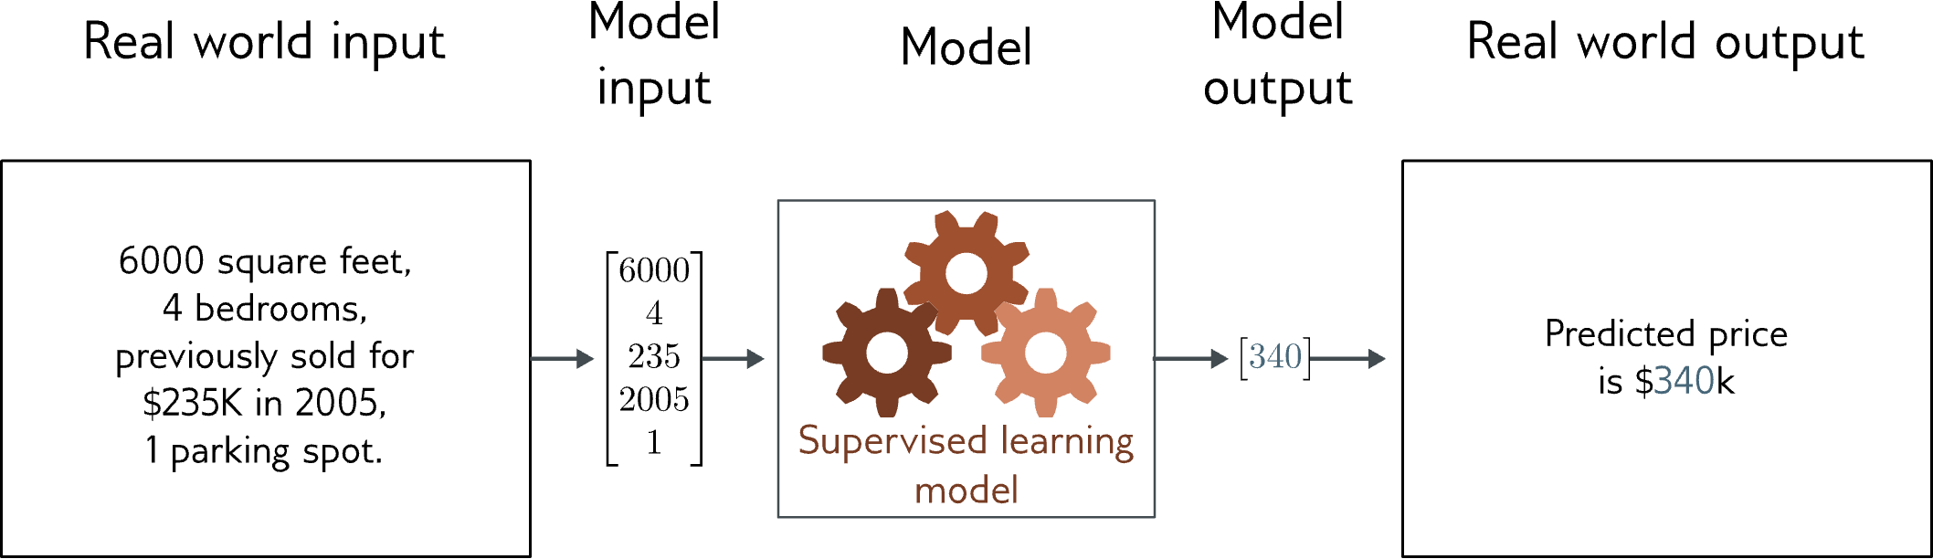
Regression
Univariate regression problem (one output, real value)
Fully connected network

Slide 3
Example: 1D Linear regression loss function
Loss function:
“Least squares loss function”

Slide 4
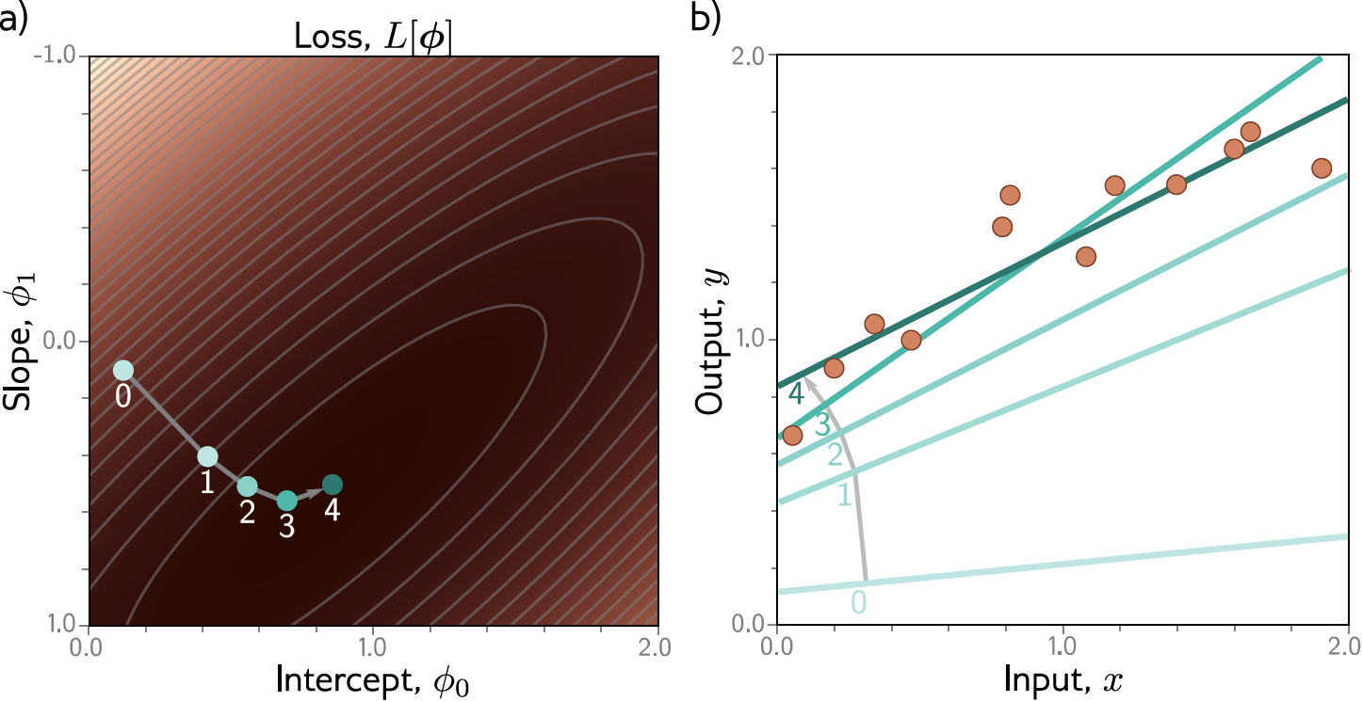
Example: 1D Linear regression training
This technique is known as gradient descent

Slide 5
Shallow neural networks
1D regression model is obviously limited
Want to be able to describe input/output that are not lines
Want multiple inputs
Want multiple outputs
Shallow neural networks
Flexible enough to describe arbitrarily complex input/output mappings
Can have as many inputs as we want
Can have as many outputs as we want

Slide 6
Shallow neural networks
Example network, 1 input, 1 output
Universal approximation theorem
More than one output
More than one input
General case
Number of regions
Terminology

Slide 7
1D Linear Regression
Example shallow network

Slide 8
Example shallow network

Slide 9
Example shallow network
Activation function

Slide 10
Example shallow network
Activation function
Rectified Linear Unit
(particular kind of activation function)

Slide 11
Example shallow network
Activation function
Rectified Linear Unit
(particular kind of activation function)

Slide 12
Example shallow network
This model has 10 parameters:
Represents a family of functions
Parameters determine particular function
Given parameters can perform inference (run equation)
Given training dataset
Define loss function (least squares)
Change parameters to minimize loss function

Slide 13
Example shallow network

Slide 14
Example shallow network
Piecewise linear functions with three joints

Slide 15
Hidden units
Break down into two parts:
where:
Hidden units

Slide 16
1. compute three linear functions

Slide 17
2. Pass through ReLU functions (creates hidden units)

Slide 18
2. Weight the hidden units

Slide 19
4. Sum the weighted hidden units to create output

Slide 20
Example shallow network
Example shallow network = piecewise linear functions
1 “joint” per ReLU function

Slide 21
Activation pattern = which hidden units are activated
Shaded region:
Unit 1 active
Unit 2 inactive
Unit 3 active

Slide 22
Depicting neural networks
Each parameter multiplies its source and adds to its target

Slide 23
Depicting neural networks

Slide 24
Shallow neural networks
Example network, 1 input, 1 output
Universal approximation theorem
More than one output
More than one input
General case
Number of regions
Terminology

Slide 25
With 3 hidden units:
With D hidden units:

Slide 26
With enough hidden units…
… we can describe any 1D function to arbitrary accuracy

Slide 27
Universal approximation theorem
“a formal proof that, with enough hidden units, a shallow neural network can describe any continuous function on a compact subset of to arbitrary precision”

Slide 28
Shallow neural networks
Example network, 1 input, 1 ouput
Universal approximation theorem
More than one output
More than one input
General case
Number of regions
Terminology

Slide 29
Two outputs
1 input, 4 hidden units, 2 outputs

Slide 30
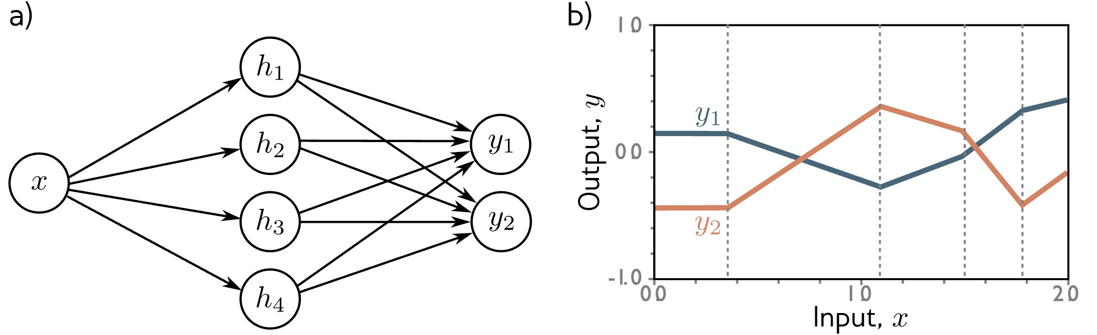
Two outputs
1 input, 4 hidden units, 2 outputs

Slide 31
Two outputs
1 input, 4 hidden units, 2 outputs

Slide 32
Shallow neural networks
Example network, 1 input, 1 ouput
Universal approximation theorem
More than one output
More than one input
General case
Number of regions
Terminology

Slide 33
Two inputs
2 inputs, 3 hidden units, 1 output

Slide 34
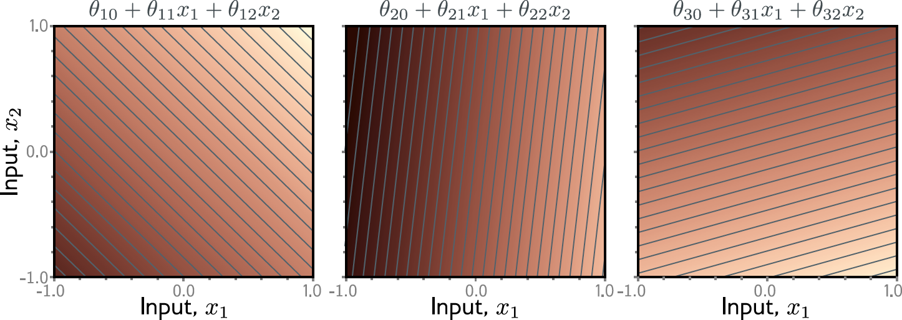

Slide 35
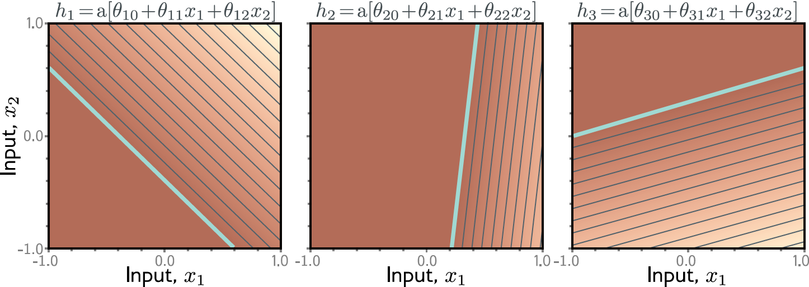

Slide 36
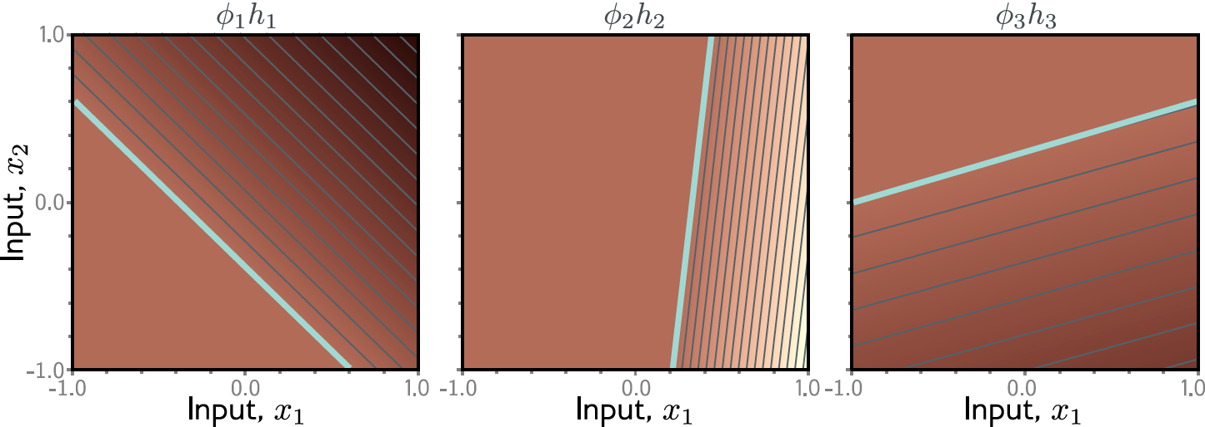

Slide 37
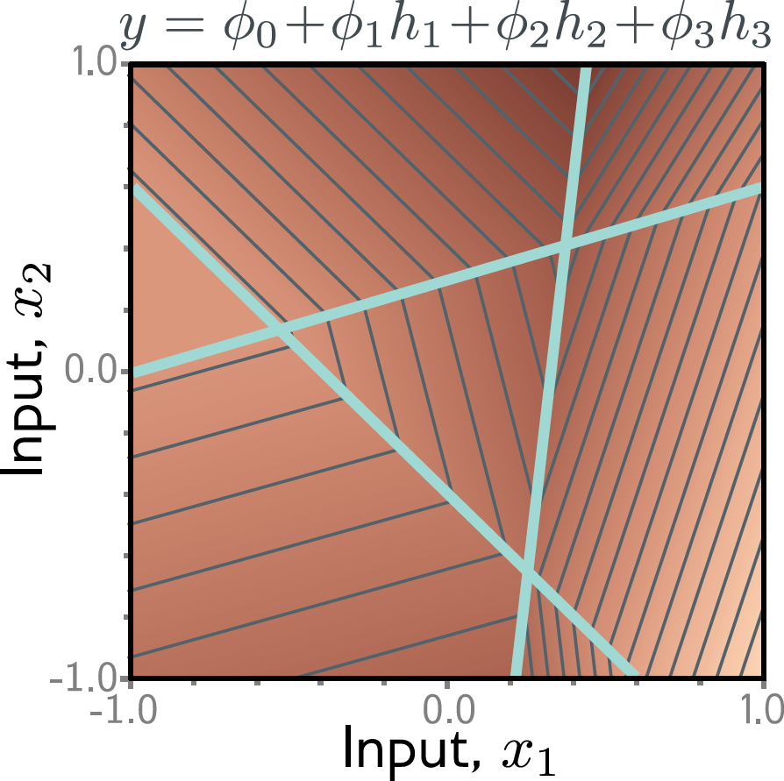

Slide 38
Convex polygons

Slide 39
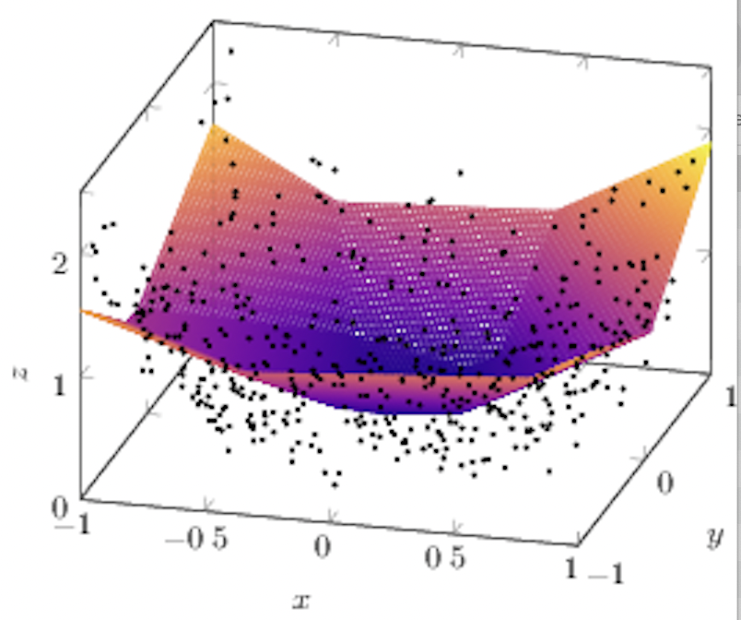
Fitting

Slide 40
Question:
For the 2D case, what if there were two outputs?
If this is one of the outputs, what would the other one look like?

Slide 41
Shallow neural networks
Example network, 1 input, 1 ouput
Universal approximation theorem
More than one output
More than one input
General case
Number of regions
Terminology

Slide 42
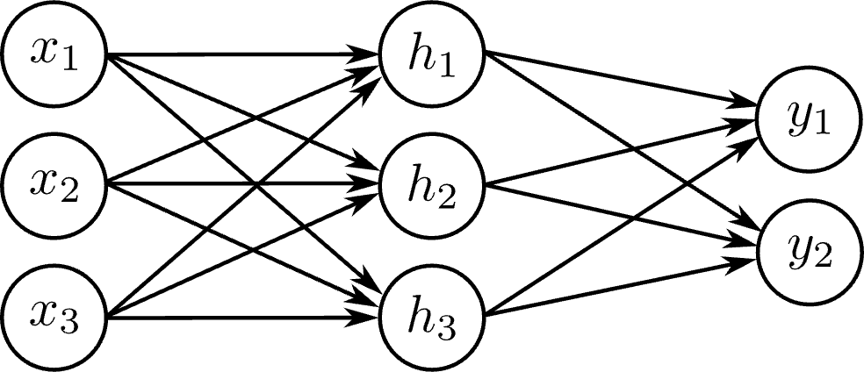
Arbitrary inputs, hidden units, outputs
$D_{o}$Outputs, D hidden units, and $D_{i}$ inputs
e.g., Three inputs, three hidden units, two outputs

Slide 43
Question:
How many parameters does this model have?

Slide 44
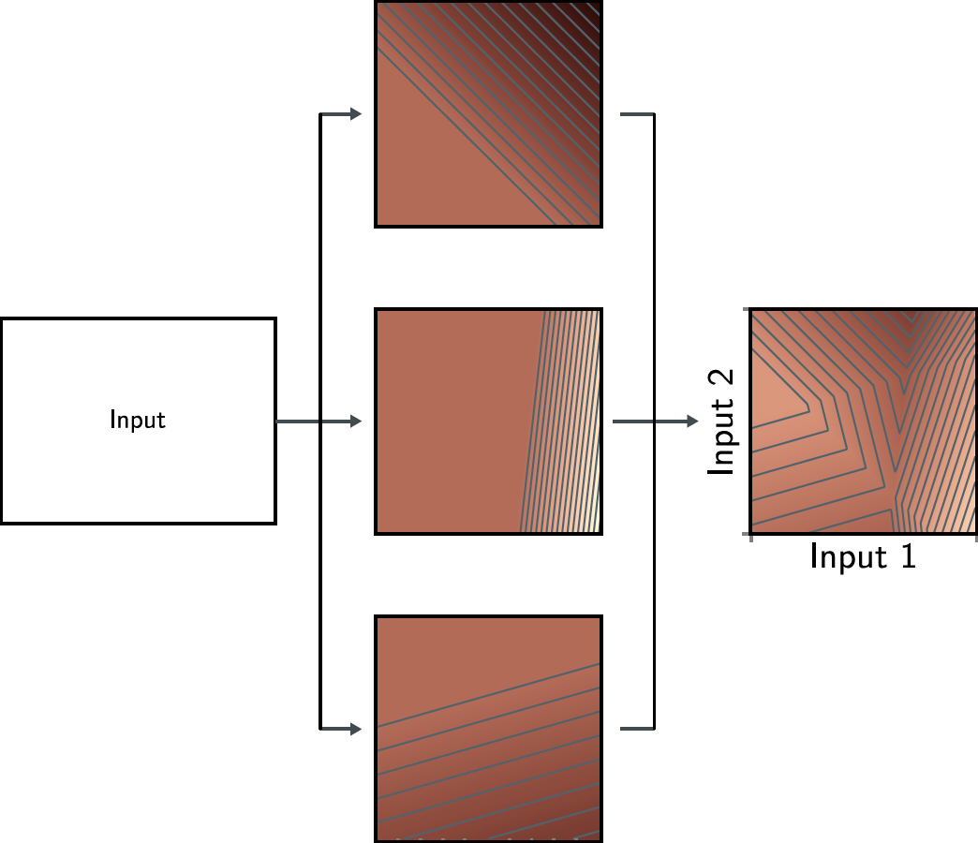
Notes:
If we combine three of these functions with j

Slide 45
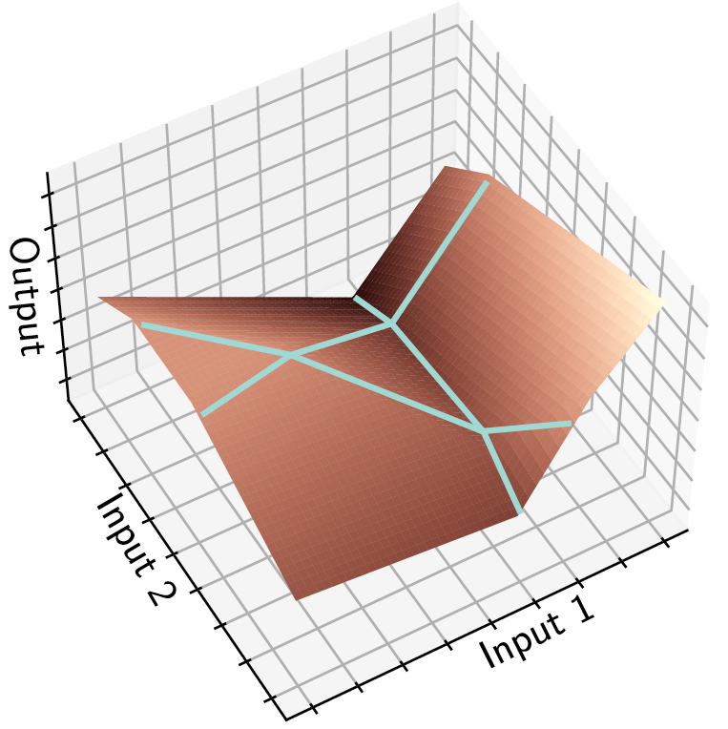
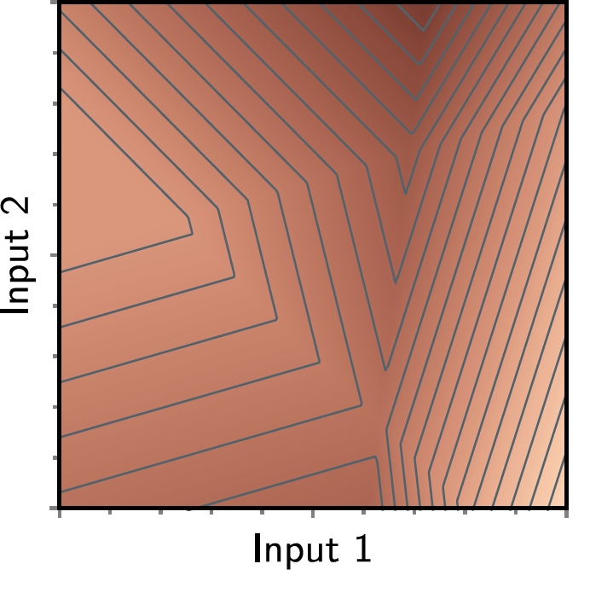

Slide 46
Neurons
Inputs
Output
“neural network”
Notes:
Again, we can draw this model as a “neural network”, and again it is just an equation, with the inputs on the rights, the output on the left, and a bunch of parameters (in blue) that determine the shape of the function.
This idea extends to three inputs – now we would have a volume with an output at each position in the volume. We would make functions which just changed smoothly in one direction in 3D space, cut them off where they are less than zero and recombine and we’d get some complicated function in 3D.
And the idea extends to larger numbers of inputs too… I just can’t draw or explain it any more… it’s best thought of as a more complicated equation.

Slide 47
Arbitrary inputs, hidden units, outputs
$D_{o}$Outputs, D hidden units, and $D_{i}$ inputs
e.g., Three inputs, three hidden units, two outputs

Slide 48
Shallow neural networks
Example network, 1 input, 1 ouput
Universal approximation theorem
More than one output
More than one input
General case
Number of regions
Terminology

Slide 49
Number of output regions
In general, each output consists of D dimensional convex polytopes
With two inputs, and three outputs, we saw there were seven polygons:

Slide 50
Number of output regions
In general, each output consists of D dimensional convex polytopes
How many?
Highlighted point = 500 hidden units or 51,001 parameters

Slide 51
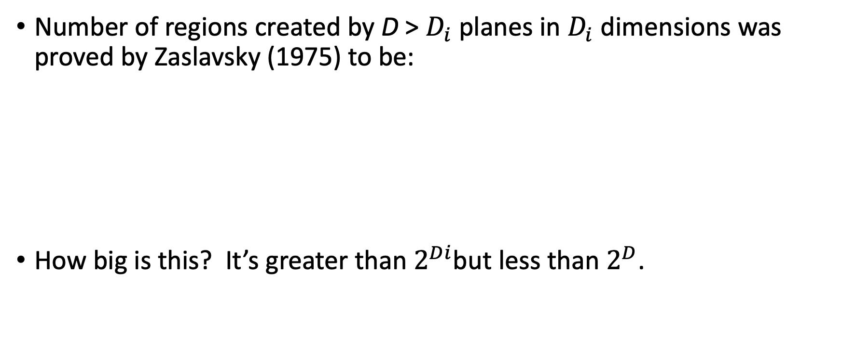
Number of regions:
Number of regions created by D > $D_{i}$ planes in $D_{i}$ dimensions was proved by Zaslavsky (1975) to be:
How big is this? It’s greater than $2^{Di}$but less than $2^{D}$.
Binomial coefficients!

Slide 52

Proof that bigger than larger than $2^{Di}$
1D input with 1 hidden
unit creates two regions
(one joint)
2D input with 2 hidden
units creates four regions
(two lines)
3D input with 3 hidden
units creates eight regions
(three planes)

Slide 53
Shallow neural networks
Example network, 1 input, 1 ouput
Universal approximation theorem
More than one output
More than one input
General case
Number of regions
Terminology

Slide 54
Nomenclature

Slide 55
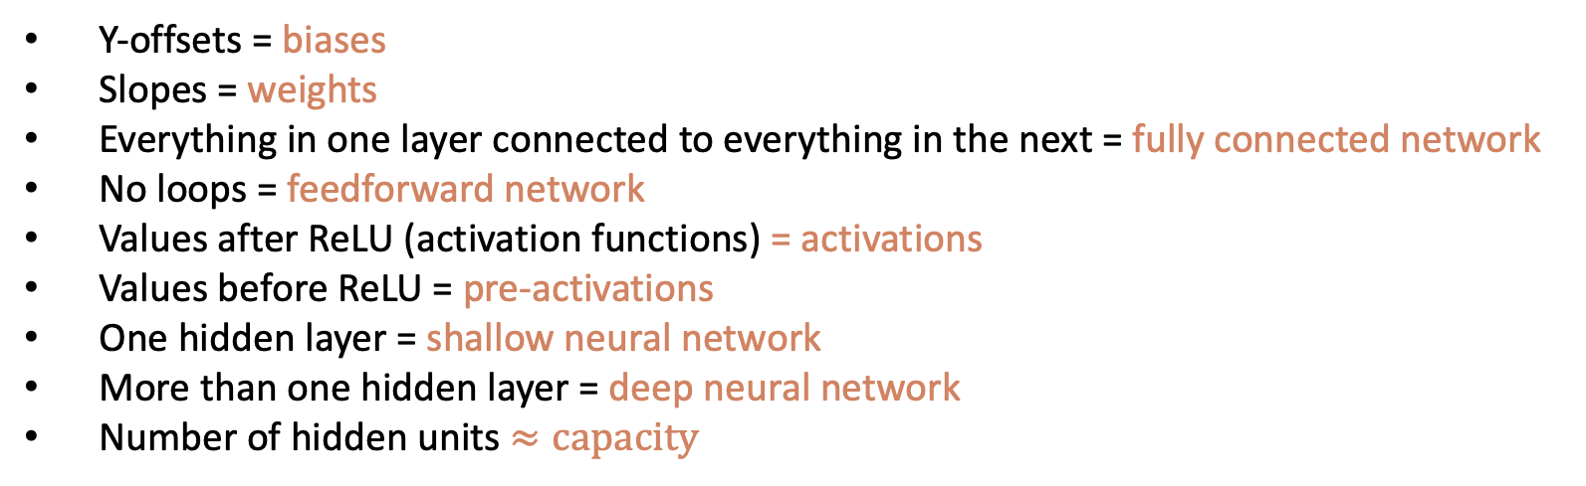
Nomenclature
Y-offsets = biases
Slopes = weights
Everything in one layer connected to everything in the next = fully connected network
No loops = feedforward network
Values after ReLU (activation functions) = activations
Values before ReLU = pre-activations
One hidden layer = shallow neural network
More than one hidden layer = deep neural network
Number of hidden units $≈capacity$

Slide 56
Other activation functions

Slide 57
Regression
We have built a model that can:
take an arbitrary number of inputs
output an arbitrary number of outputs
model a function of arbitrary complexity between the two

Slide 58
Next time:
What happens if we feed one neural network into another neural network?

Slide 59

Feedback

